Slide 1

New Curriculum
Penywaun Primary School
Governors Presentation

Slide 2
Mission Statement
"Believe we can achieve"

Slide 3
Vision
Our Vision
We should strive to teach ‘the basics’ to all of our learners. We should aim to deliver a broad, balanced curriculum with the well-being of our learners and staff at the heart of all that we do. We should aim to deliver our teaching in a fun, energetic way, that engages our learners and excites them.
We would like our children to be taught by a teacher that will keep them safe, has time for them, is kind, thoughtful, will go above and beyond for them and will forge a positive relationship with them. A teacher that has their child’s well-being at heart and shows humour and gives off an energy that inspires and invigorates.
We believe that we have a school that the community can be proud of.
Parents are happy to send their children to our school knowing that they will be kept safe, be taught exciting lessons and their well-being needs will always be at the forefront.

Slide 4
Curriculum 2022 "A Curriculum of Ambition"
Our Curriculum
At Penywaun Primary School we believe we have developed a purpose-led curriculum, which has a secure foundation on the Four Purposes of the Curriculum for Wales 2022. Our curriculum design is broad and balanced with a focus on the acquisition of knowledge and skills, whilst ensuring it is both motivating and challenging to engage pupils and foster a love of learning.
We will follow a thematic approach and begin each term with a ‘lift off day’ to immerse the children in the theme and end with a ‘landing day’ where children celebrate the knowledge, skills and experience they have acquired.

Slide 5

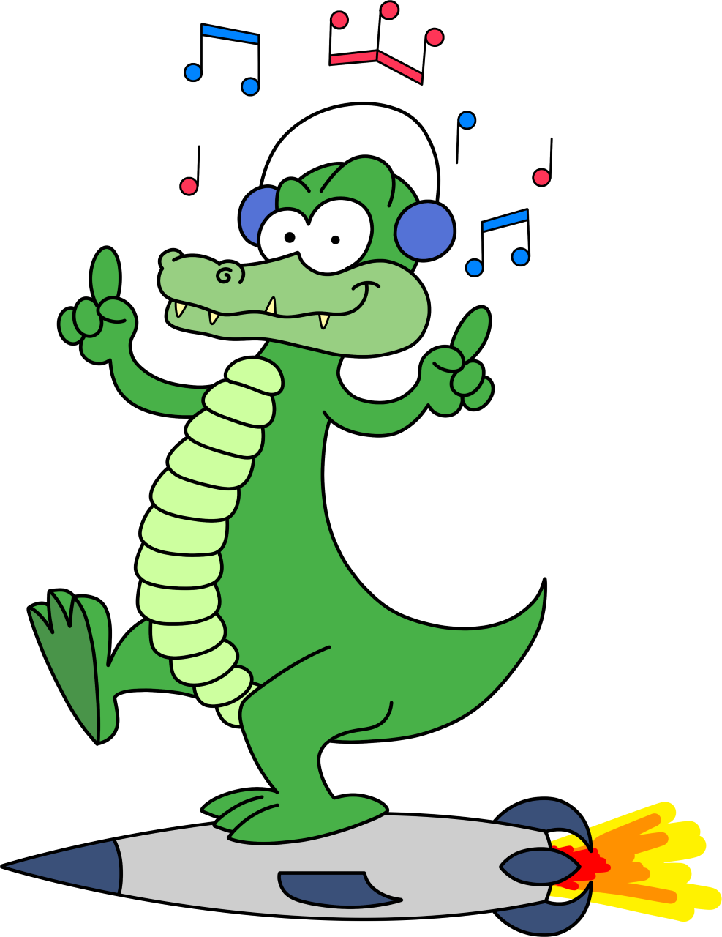
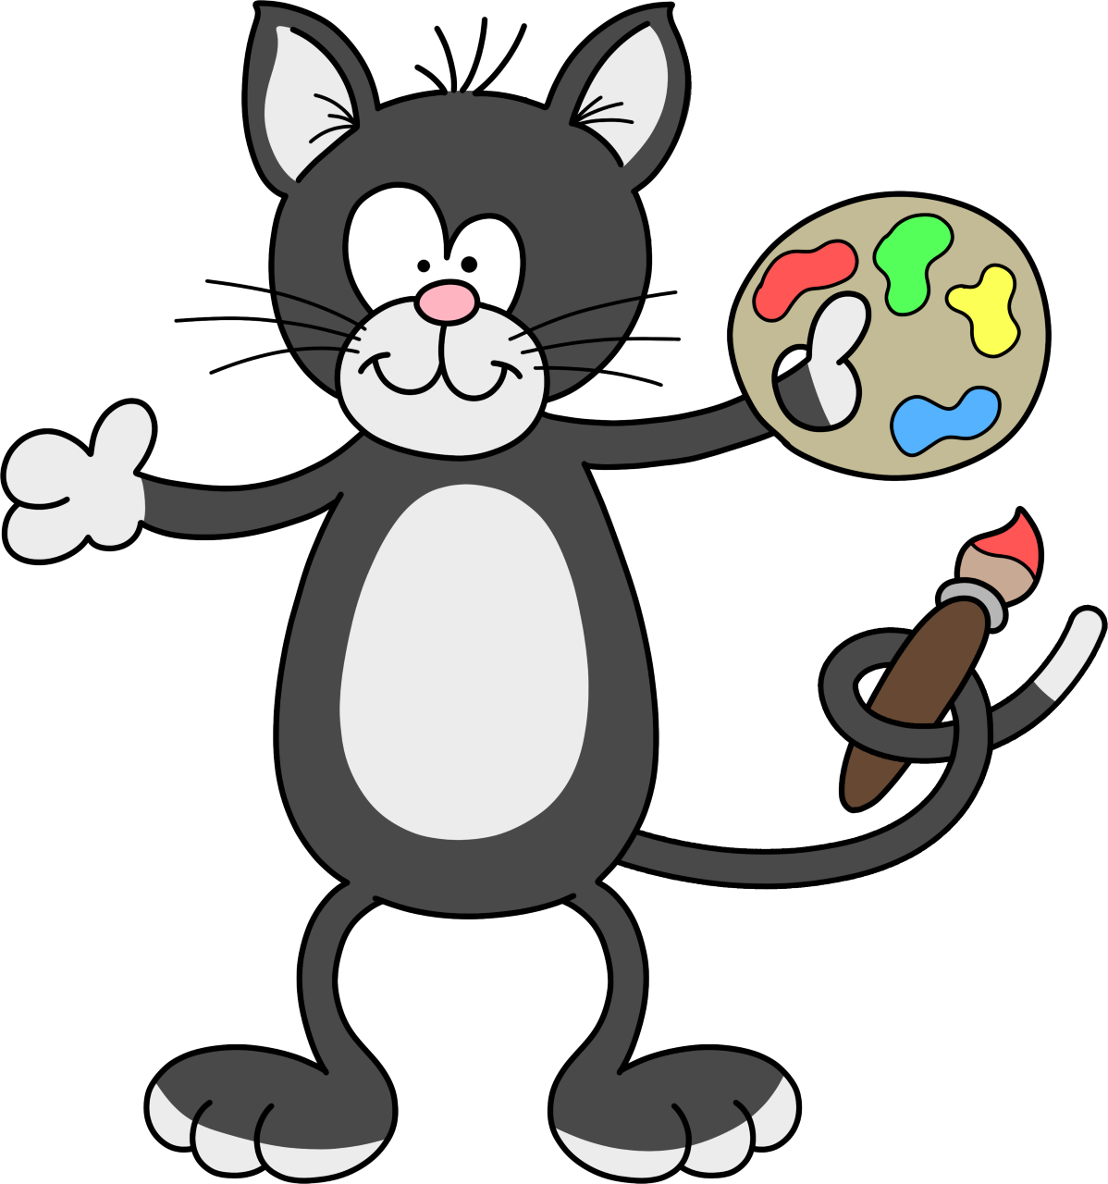

School Values
The four purposes are our starting point for everything we do and are trying to achieve. The aim of our school’s curriculum is to support our learners to become:
4 Core Purposes
At Penywaun Primary School our 4 core purposes are represented by characters the children have designed.
Ambitious Capable Learners ready to learn throughout their lives- Arthur the Ambitious Ant
Ethically Informed Citizens of Wales and the world- Elen the Ethical Eagle
Enterprising, Creative Contributors ready to play a full part in life and work - Carys the Creative Cat
Healthy Confident Individuals ready to lead fulfilling lives as valued members of society- Caradoc the Confident Crocodile.

Slide 6
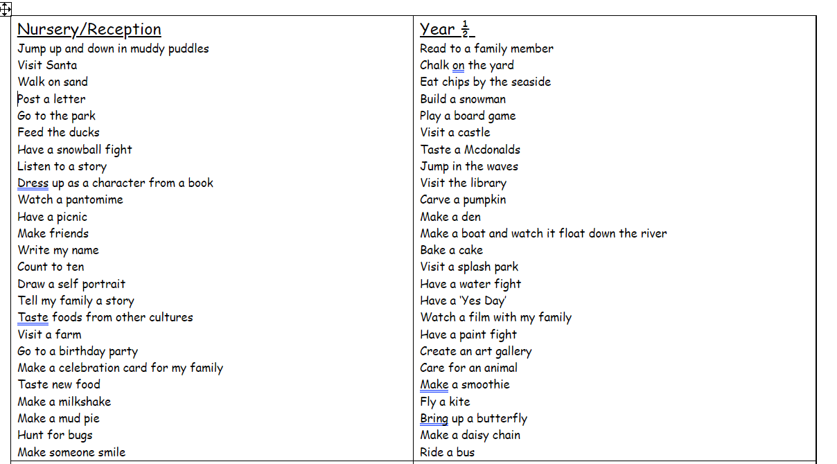
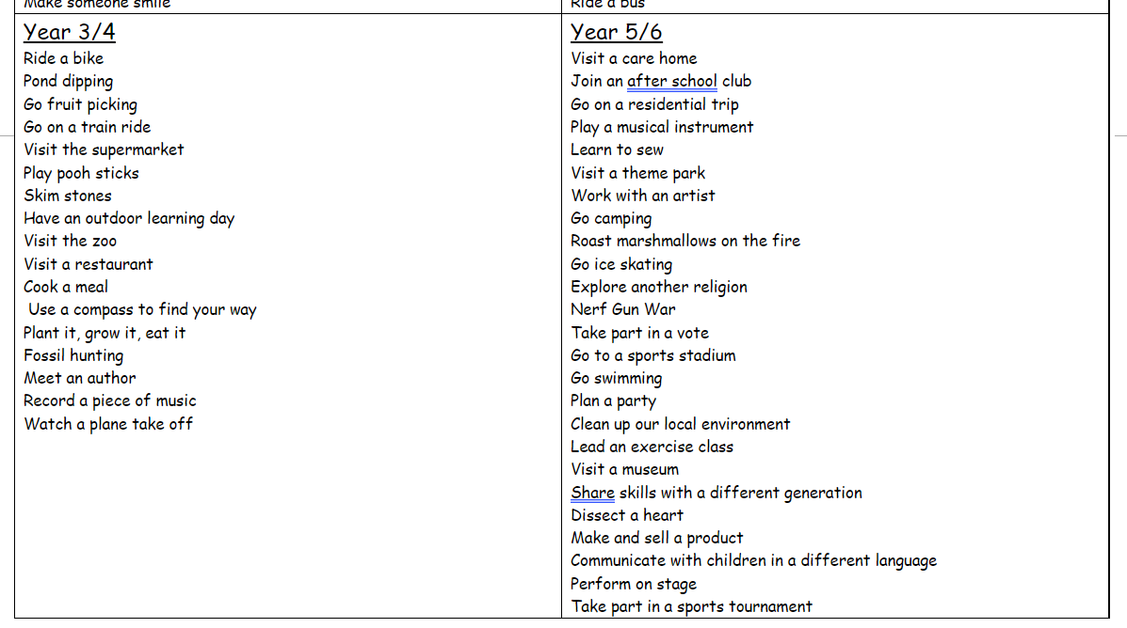
Experiences @ Penywaun Primary School

Slide 7
 | Lead
Language, Literacy and Communication | Mrs Griffiths/MrsMarsh
Mathematics and Numeracy | Mrs Pugh
Health and Wellbeing | Mr Prichard/Mrs Hancock
Expressive Arts | Mrs Higgins
Science and Technology | Mrs Rogers/Mrs Windmill
Humanities | Mrs Stone

Slide 8
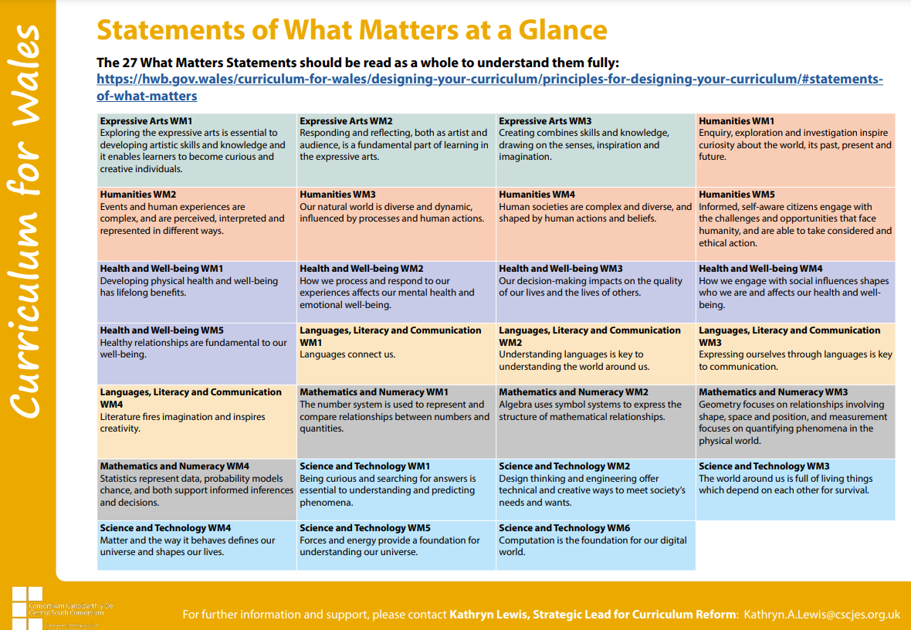
What Matters Statements

Slide 9
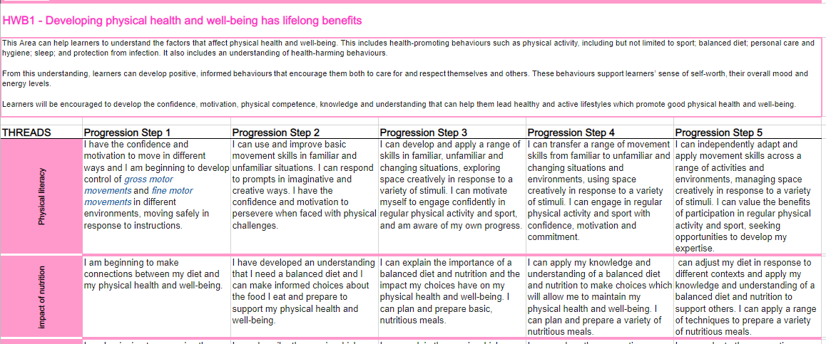
Descriptions of Learning

Slide 10
Autumn 2022
Whole school topic: The Best of Me
Primary AoLE: Health and Wellbeing
Concept Driver: Identity
Reception- Who am I?
Year 1- What happens as I grow?
Year 2-How does happy feel?
Year 3-How does my heart beat?
Year 4- What is that sound I hear?
Year 5- What are my rights?
Year 6- How can I ensure my mind and body are healthy?

Slide 11
Looking Ahead
2022 - 2023 | Primary AoLE | Concept Driver
Autumn | Health and Wellbeing | Identity
Spring | Humanities | Invention
Summer | Science and Technology | Culture

Slide 12
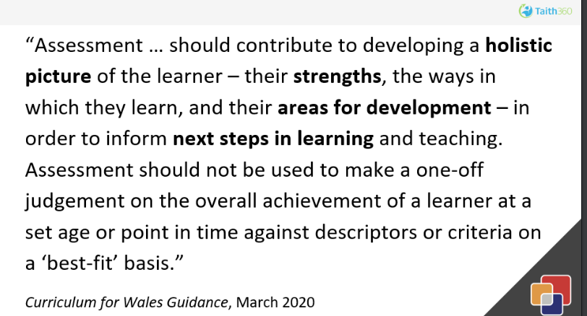
Taith 360 - A Planning and Assessment Tool

Slide 13
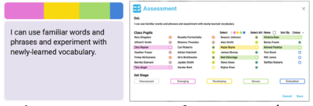
Taith 360 - A Planning and Assessment Tool

